Slide 1

Introduction To Parallel Computing
이 정 근 (Jeong-Gun Lee)
임베디드 SoC 연구실, 한림대학교 소프트웨어융합대학
www.onchip.net
Email: Jeonggun.Lee@hallym.ac.kr

Slide 2
Contents
Parallel Computing: 소개
Parallel Computing: 왜?
Serial Computation
Parallel Computation
Instruction Level Parallelism / Parallel Computers
Parallel programming models
Parallelizing your programs
Analytic Measure for Parallel Algorithms

Slide 3

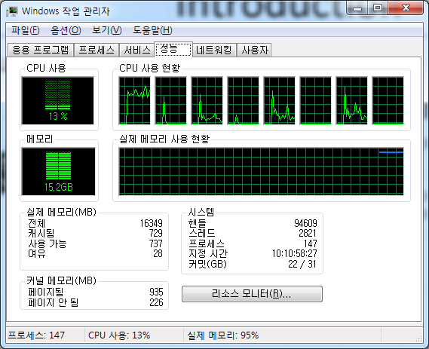
Parallel Computing
Multicore/Manycore and GPU

Slide 4
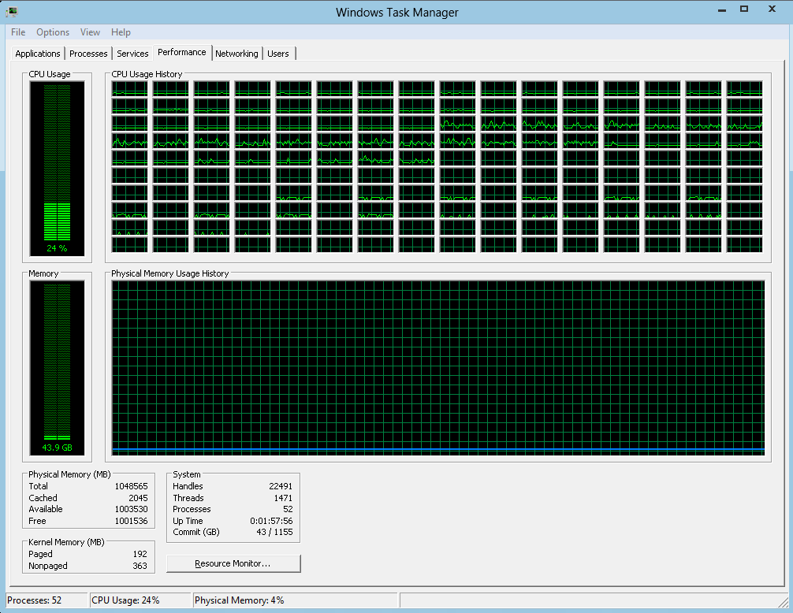

Parallel Computing
Multicore/Manycore and GPU

Slide 5

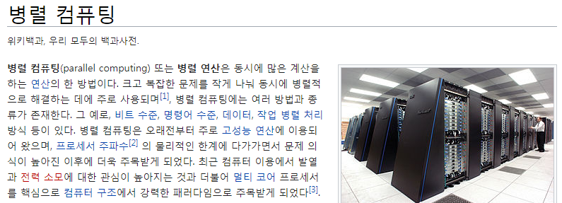
Parallel Computing
First, Wiki Definition …
프로세서 주파수 의 물리적인 한계에 다가가면서 문제 의식이 높아진 이후에 더욱 주목 받게 되었다. 최근 컴퓨터 이용에서 발열과 전력 소모에 대한 관심이 높아지는 것과 더불어 멀티 코어 프로세서를 핵심으로 컴퓨터 구조에서 강력한 패러다임으로 주목

Slide 6
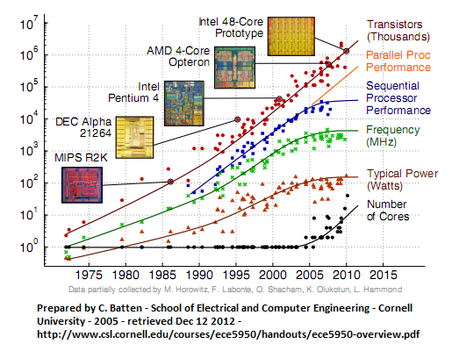

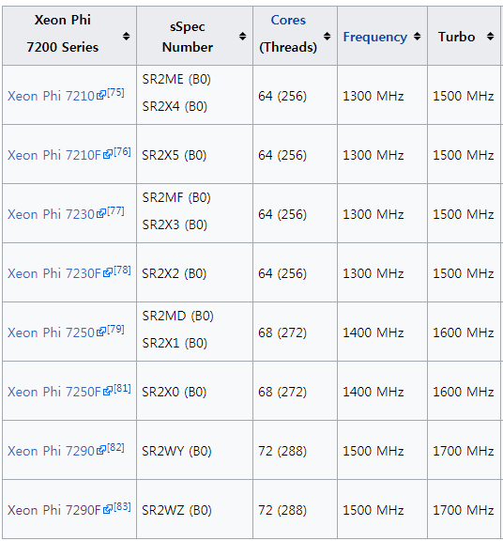
Parallel Computing: Why ?
프로세서 주파수 의 물리적인 한계에 다가가면서 문제 의식이 높아진 이후에 더욱 주목 받게 되었다. 최근 컴퓨터 이용에서 발열과 전력 소모에 대한 관심이 높아지는 것과 더불어 멀티 코어 프로세서를 핵심으로 컴퓨터 구조에서 강력한 패러다임으로 주목
Each core will have two 512-bit vector units and will support AVX-512 SIMD instructions

Slide 7
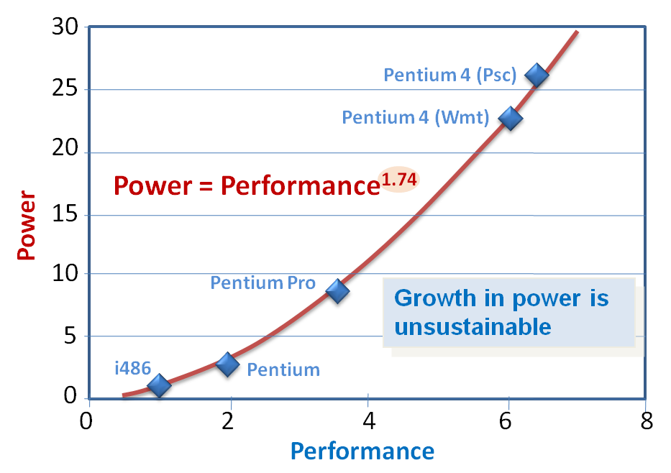
Parallel Computing: Why ?
프로세서 주파수 의 물리적인 한계에 다가가면서 문제 의식이 높아진 이후에 더욱 주목 받게 되었다. 최근 컴퓨터 이용에서 발열과 전력 소모에 대한 관심이 높아지는 것과 더불어 멀티 코어 프로세서를 핵심으로 컴퓨터 구조에서 강력한 패러다임으로 주목
Worse news: Power (normalized to i486) trends
Multi-core
Parallelism is an energy-efficient way to achieve performance [Chandrakasan et al 1992]
A larger number of smaller processing elements allows a finer-grained ability to perform dynamic voltage scaling and power down
Source: Ed Grochowski, Ronny Ronen, John Shen, Hong Wang, "Best of Both Latency and Throughput," Computer Design, International Conference on, pp. 236-243, 2004

Slide 8
Parallel Computing: Why ?
프로세서 주파수 의 물리적인 한계에 다가가면서 문제 의식이 높아진 이후에 더욱 주목 받게 되었다. 최근 컴퓨터 이용에서 발열과 전력 소모에 대한 관심이 높아지는 것과 더불어 멀티 코어 프로세서를 핵심으로 컴퓨터 구조에서 강력한 패러다임으로 주목
Worse news: Power (normalized to i486) trends
Multi-core
Parallelism is an energy-efficient way to achieve performance [Chandrakasan et al 1992]
A larger number of smaller processing elements allows a finer-grained ability to perform dynamic voltage scaling and power down
Small is Beautiful !
That does not immediately imply that “smallest is best” !
Source: Ed Grochowski, Ronny Ronen, John Shen, Hong Wang, "Best of Both Latency and Throughput," Computer Design, International Conference on, pp. 236-243, 2004

Slide 9

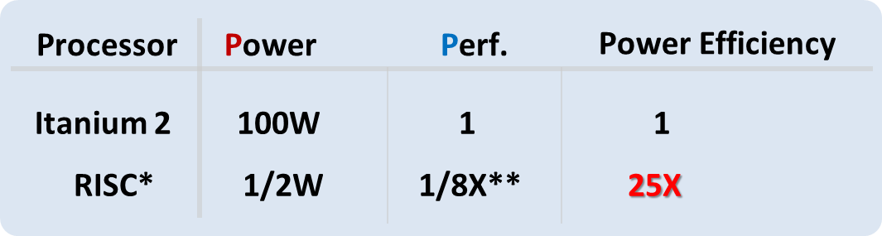
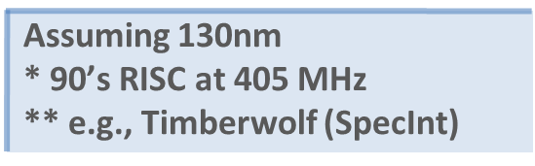
Parallel Computing: Why ?
프로세서 주파수 의 물리적인 한계에 다가가면서 문제 의식이 높아진 이후에 더욱 주목 받게 되었다. 최근 컴퓨터 이용에서 발열과 전력 소모에 대한 관심이 높아지는 것과 더불어 멀티 코어 프로세서를 핵심으로 컴퓨터 구조에서 강력한 패러다임으로 주목
Multi-core Challenges: The 3 P’s
Performance challenge
Power efficiency challenge
Programming challenge
Anant Agarwal (professor at MIT), "Going Multi-core: Opportunities, Challenges and Dreams" in his keynote talk at MULTI-CORE EXPO, Mar. 2006

Slide 10

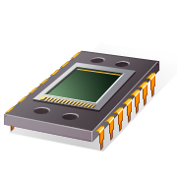
Parallel Computing: Why ?
프로세서 주파수 의 물리적인 한계에 다가가면서 문제 의식이 높아진 이후에 더욱 주목 받게 되었다. 최근 컴퓨터 이용에서 발열과 전력 소모에 대한 관심이 높아지는 것과 더불어 멀티 코어 프로세서를 핵심으로 컴퓨터 구조에서 강력한 패러다임으로 주목
manycore
+ Diminishing Return
manycore

Slide 11
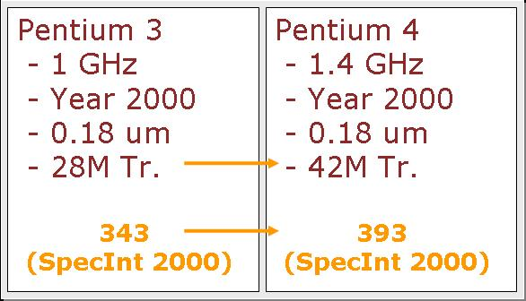
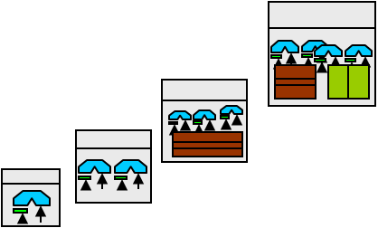
Parallel Computing: Why ?
프로세서 주파수 의 물리적인 한계에 다가가면서 문제 의식이 높아진 이후에 더욱 주목 받게 되었다. 최근 컴퓨터 이용에서 발열과 전력 소모에 대한 관심이 높아지는 것과 더불어 멀티 코어 프로세서를 핵심으로 컴퓨터 구조에서 강력한 패러다임으로 주목
Diminishing Return
Performance
(GOPS)
1000
Transistors
The Moore’s Gap
50%↑
100
15%↑
10
SMT
Performance
OoO
1
superscalar
Diminishing returns from single CPU
Wire delays
Power envelopes
pipelining
0. 1
0.01
1992
1998
2002
2006
2010
time

Slide 12
Parallel Computing: Why ?
프로세서 주파수 의 물리적인 한계에 다가가면서 문제 의식이 높아진 이후에 더욱 주목 받게 되었다. 최근 컴퓨터 이용에서 발열과 전력 소모에 대한 관심이 높아지는 것과 더불어 멀티 코어 프로세서를 핵심으로 컴퓨터 구조에서 강력한 패러다임으로 주목
manycore
+ Diminishing Return
manycore
Manycore
➔ Parallel Computing

Slide 13
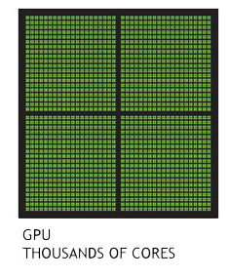
Parallel Computing: Why ?
프로세서 주파수 의 물리적인 한계에 다가가면서 문제 의식이 높아진 이후에 더욱 주목 받게 되었다. 최근 컴퓨터 이용에서 발열과 전력 소모에 대한 관심이 높아지는 것과 더불어 멀티 코어 프로세서를 핵심으로 컴퓨터 구조에서 강력한 패러다임으로 주목
manycore
+ Diminishing Return
manycore
GPU
Manycore
➔ Parallel Computing

Slide 14

Parallel Computing: Why ?
프로세서 주파수 의 물리적인 한계에 다가가면서 문제 의식이 높아진 이후에 더욱 주목 받게 되었다. 최근 컴퓨터 이용에서 발열과 전력 소모에 대한 관심이 높아지는 것과 더불어 멀티 코어 프로세서를 핵심으로 컴퓨터 구조에서 강력한 패러다임으로 주목
manycore
+ Diminishing Return
manycore
Manycore
➔ Parallel Computing

Slide 15
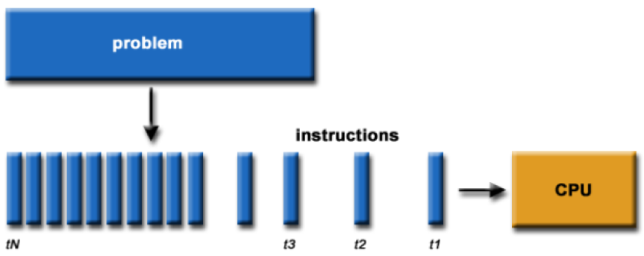
Serial Computation
Traditionally software has been written for serial computations:
A problem is broken into a discrete set of instructions(컴파일)
Instructions are executed one after another
Only one instruction can be executed at any moment in time

Slide 16
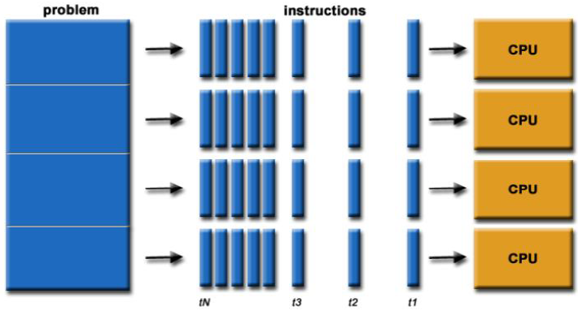
Parallel Computing
Simply, parallel computing is the simultaneous use of multiple compute resources to solve a computational problem:
To be run using multiple CPUs
A problem is broken into discrete parts that can be solved concurrently (Task-Level or Data-Level Parallelism)
Each part is further broken down to a series of instructions
Instructions from each part execute simultaneously on different CPUs

Slide 17
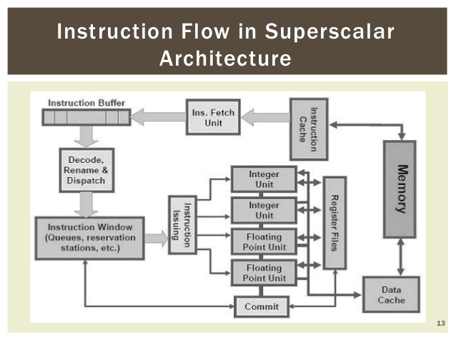
Single CPU → No Parallelism ?
If a CPU has multiple functional units ?
Instruction Level Parallelism
(ILP)

Slide 18
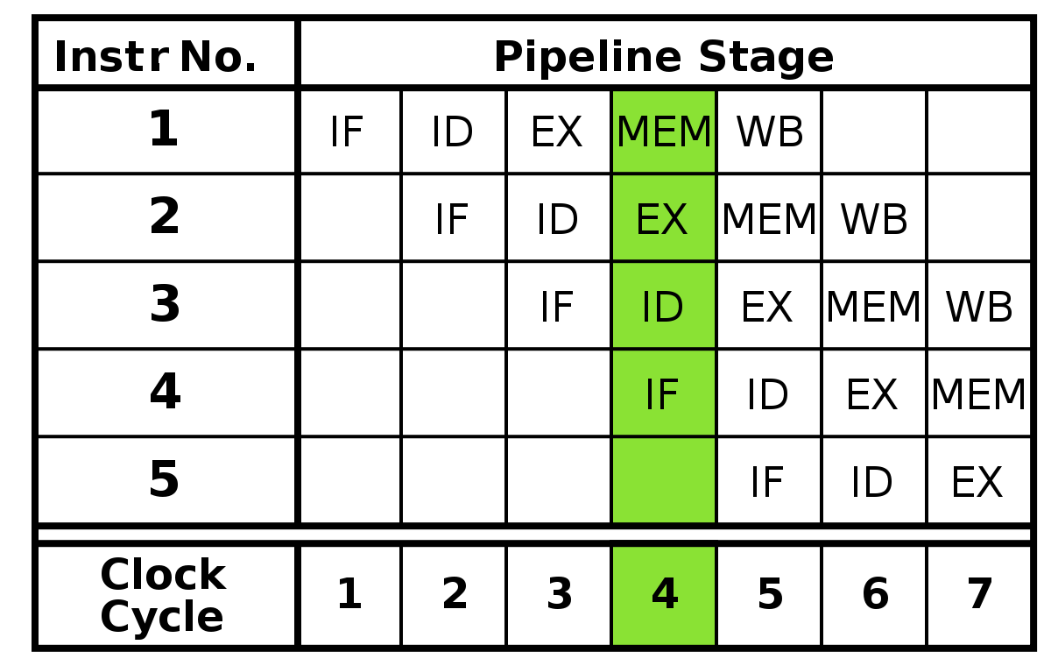
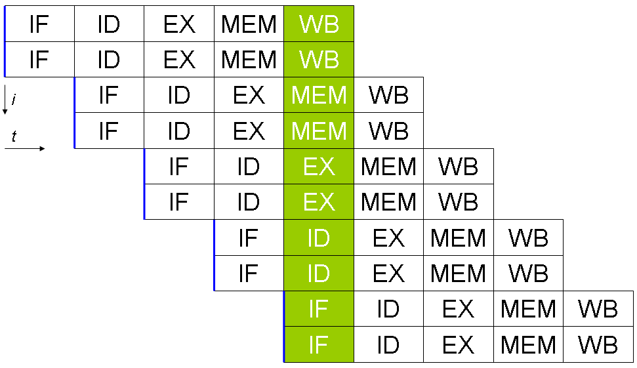
Instruction Level Parallelism
ILP = Instruction Level Parallelism
Even in a single CPU, more than one instruction can be executed at a time with advanced microarchitecture techniques

Slide 19
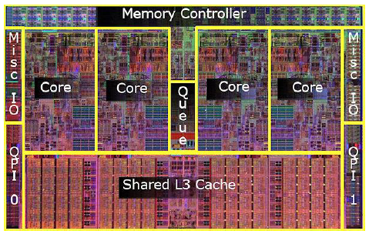
Parallel Computers
Virtually all stand-alone computers today are parallel machines from a hardware perspective:
Multiple functional units (floating point, integer, GPU, etc.)
Multiple execution units / cores
Multiple hardware threads
Intel Core i7 CPU and its major components

Slide 20
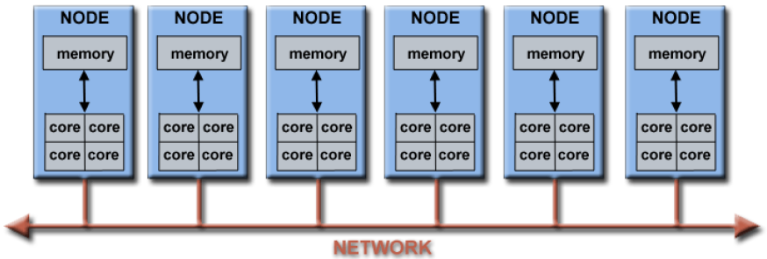
Parallel Computers
Networks connect multiple stand-alone computers (nodes) to create larger parallel computer clusters
Each compute node is a multi-processor parallel computer in itself
Multiple compute nodes are networked together with an InfiniBand network
Special purpose nodes, also multi-processor, are used for other purposes

Slide 21
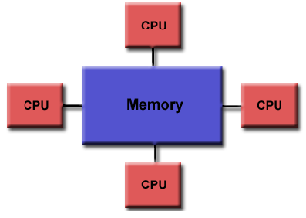
Parallel Computer Memory Architectures
Shared Memory (공유메모리):
Multiple processors can operate independently, but share the same memory resources
Changes in a memory location caused by one CPU are visible to all processors
Advantages:
- Global address space provides a user-friendly programming perspective to memory
- Fast and uniform data sharing due to proximity of memory to CPUs
Disadvantages:
- Lack of scalability between memory and CPUs. Adding more CPUs increases traffic on the shared memory-CPU path
- Programmer responsibility for “correct” access to global memory

Slide 22
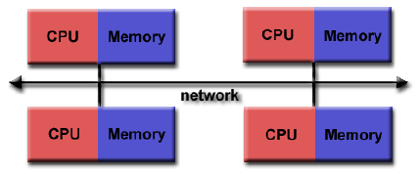
Parallel Computer Memory Architectures
Distributed Memory(분산메모리):
Requires a communication network to connect inter-processor memory
Processors have their own local memory.
Changes made by one CPU have no effect on others
Requires communication to exchange data among processors
Advantages:
- Memory is scalable with the number of CPUs
- Each CPU can rapidly access its own memory without overhead incurred with trying to maintain global cache coherency
Disadvantages:
- Programmer is responsible for many of the details associated with data communication between processors

Slide 23
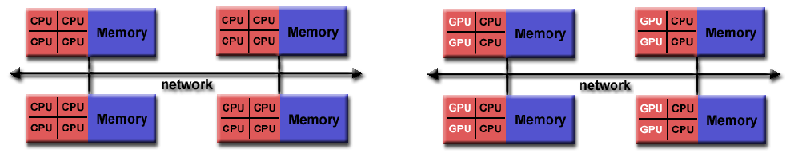
Parallel Computer Memory Architectures
Hybrid Distributed-Shared Memory(분산공유메모리):
The largest and fastest computers in the world today employ both shared and distributed memory architectures.
Shared memory component can be a shared memory machine and/or GPU
Processors on a compute node share same memory space
Requires communication to exchange data between compute nodes

Slide 24
Parallel Programming Models
Parallel Programming Models exist as an abstraction above hardware and memory architectures
Shared Threads Models (Pthreads, OpenMP)
Distributed Memory / Message Passing (MPI)
Single Instruction/Program Multiple Data (SIMD, SPMD)
Vector Processing (MMX, SSE, AVX, …)
Single Instruction Multiple Thread (SIMT for GPU)
…

Slide 25
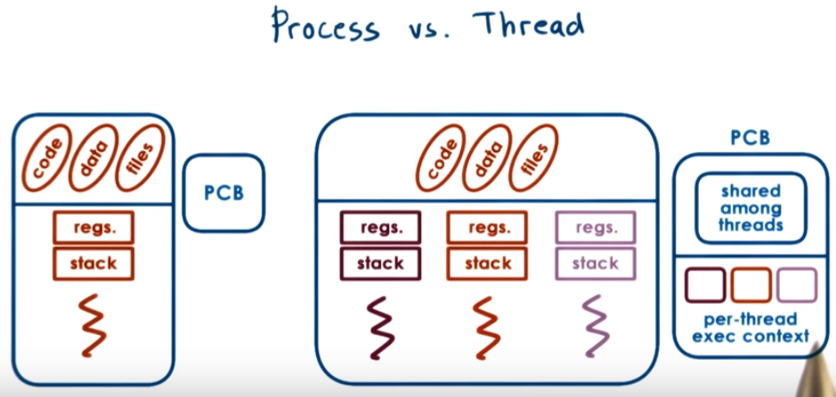
Shared Threads Models
POSIX Threads
POSIX (포직스, /ˈpɒzɪks/)는 이식 가능 운영 체제 인터페이스(移植可能運營體制 interface, portable operating system interface)의 약자로, 서로 다른 UNIX OS의 공통 API를 정리하여 이식성이 높은 유닉스 응용 프로그램을 개발하기 위한 목적으로 IEEE가 책정한 애플리케이션 인터페이스 규격이다.
POSIX의 마지막 글자 X는 유닉스 호환 운영체제에 보통 X가 붙는 것에서 유래한다.

Slide 26
Shared Threads Models
POSIX Threads
Library based; requires explicit parallel coding
C Language only; Interfaces for Perl, Python and others exist
Commonly referred to as Pthreads
Most hardware vendors now offer Pthreads in addition to their proprietary threads implementations
Very explicit parallelism; requires significant programmer attention to detail
POSIX (포직스, /ˈpɒzɪks/)는 이식 가능 운영 체제 인터페이스(移植可能運營體制 interface, portable operating system interface)의 약자로, 서로 다른 UNIX OS의 공통 API를 정리하여 이식성이 높은 유닉스 응용 프로그램을 개발하기 위한 목적으로 IEEE가 책정한 애플리케이션 인터페이스 규격이다.
POSIX의 마지막 글자 X는 유닉스 호환 운영체제에 보통 X가 붙는 것에서 유래한다.

Slide 27
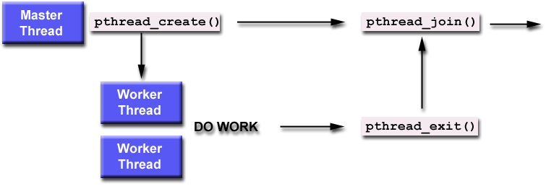
Shared Threads Models
POSIX Threads
Library based; requires parallel coding
C Language only; Interfaces for Perl, Python and others exist
Commonly referred to as Pthreads
Most hardware vendors now offer Pthreads in addition to their proprietary threads implementations
Very explicit parallelism; requires significant programmer attention to detail
POSIX (포직스, /ˈpɒzɪks/)는 이식 가능 운영 체제 인터페이스(移植可能運營體制 interface, portable operating system interface)의 약자로, 서로 다른 UNIX OS의 공통 API를 정리하여 이식성이 높은 유닉스 응용 프로그램을 개발하기 위한 목적으로 IEEE가 책정한 애플리케이션 인터페이스 규격이다.
POSIX의 마지막 글자 X는 유닉스 호환 운영체제에 보통 X가 붙는 것에서 유래한다.

Slide 28
Let’s Dive in- pth_hello.c
#include <pthread.h>
#include <stdio.h>
#include <stdlib.h>
#define NUM_THREADS 5
void *PrintHello(void *threadid)
{
long tid;
long* tidPtr = (long*) threaded;
tid = *tidPtr;
printf("Hello World! It's me, thread #%ld!\n", tid);
pthread_exit(NULL);
}
int main(int argc, char *argv[])
{
pthread_t threads[NUM_THREADS];
int rc;
long t;
for(t=0;t<NUM_THREADS;t++){
printf("In main: creating thread %ld\n", t);
rc = pthread_create(&threads[t], NULL, PrintHello, (void *)&t);
if (rc){
printf("ERROR; return code from pthread_create() is %d\n", rc);
exit(-1);
}
}
/* Last thing that main() should do */
pthread_exit(NULL);
}
210.115.230.177

Slide 29
Output
jeong-gun@jeonggun-desktop:~/PTHREAD$ ./pth_hello
In main: creating thread 0
In main: creating thread 1
Hello World! It's me, thread #1!
In main: creating thread 2
Hello World! It's me, thread #2!
In main: creating thread 3
Hello World! It's me, thread #3!
In main: creating thread 4
Hello World! It's me, thread #4!
Hello World! It's me, thread #5!
Some disorder is possible

Slide 30
Shared Threads Models
OpenMP
Compiler directive based; can use serial code
Portable / multi-platform, including Unix and Windows platforms
Available in C/C++ and Fortran implementations
Can be very easy and simple to use - provides for "incremental parallelism"

Slide 31
Shared Threads Models
OpenMP
Compiler directive based; can use serial code
Sequential Program
Parallel Program
void main() { int i, k, N=1000;
double A[N], B[N], C[N]; for (i=0; i<N; i++) { A[i] = B[i] + k*C[i] } }
#include “omp.h” void main() { int i, k, N=1000;
double A[N], B[N], C[N]; #pragma omp parallel for for (i=0; i<N; i++) {
A[i] = B[i] + k*C[i]; } }

Slide 32
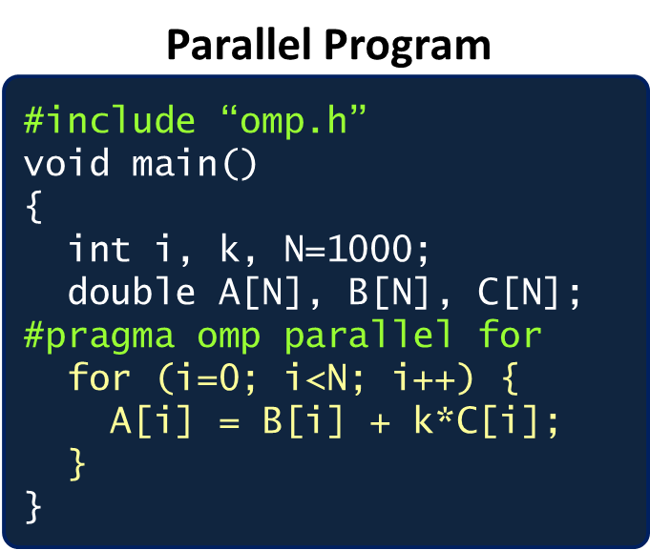
Shared Threads Models
OpenMP
Single Program Multiple Data (SPMD)
Thread 0
#include “omp.h” void main() { int i, k, N=1000;
double A[N], B[N], C[N]; lb = 0;
ub = 250;
for (i=lb;i<ub;i++) {
A[i] = B[i] + k*C[i]; } }
Thread 1
#include “omp.h” void main() { int i, k, N=1000;
double A[N], B[N], C[N]; lb = 250;
ub = 500;
for (i=lb;i<ub;i++) {
A[i] = B[i] + k*C[i]; } }
Thread 2
#include “omp.h” void main() { int i, k, N=1000;
double A[N], B[N], C[N]; lb = 500;
ub = 750;
for (i=lb;i<ub;i++) {
A[i] = B[i] + k*C[i]; } }
Thread 3
#include “omp.h” void main() { int i, k, N=1000;
double A[N], B[N], C[N]; lb = 750;
ub = 1000;
for (i=lb;i<ub;i++) {
A[i] = B[i] + k*C[i]; } }

Slide 33
OpenMP Fork-and-Join model
printf(“program begin\n”);
N = 1000;
#pragma omp parallel for
for (i=0; i<N; i++)
A[i] = B[i] + C[i];
M = 500;
#pragma omp parallel for
for (j=0; j<M; j++)
p[j] = q[j] – r[j];
printf(“program done\n”);
Serial
Parallel
Serial
Parallel
Serial

Slide 34
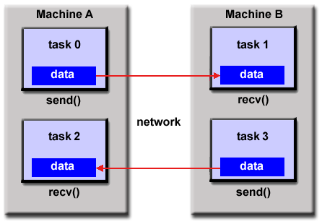
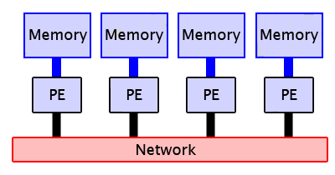
Distributed Memory / Message Passing Models
Multiple tasks can reside on the same physical machine and/or across an arbitrary number of machines
Tasks exchange data through communications by sending and receiving messages

Slide 35
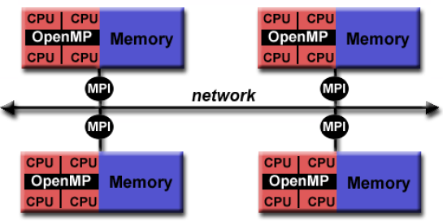
Hybrid Parallel Programming Models
Currently, a common example of a hybrid model is the combination of the message passing model (MPI) with the threads model (OpenMP)
Threads perform computationally intensive kernels using local, on-node data
Communications between processes on different nodes occurs over the network using MPI
This hybrid model lends itself well to the increasingly common hardware environment of clustered multi/many-core machines

Slide 36
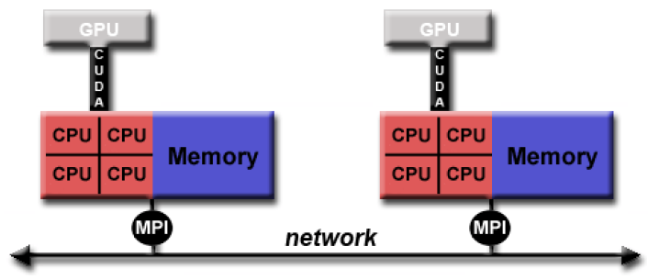
Hybrid Parallel Programming Models
Another similar and increasingly popular example of a hybrid model is using MPI with GPU (Graphics Processing Unit) programming
GPUs perform computationally intensive kernels using local, on-node data
Communications between processes on different nodes occurs over the network using MPI

Slide 37
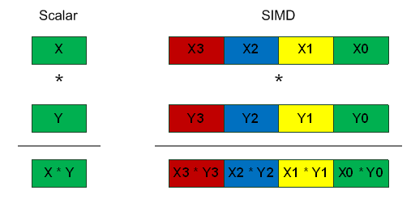
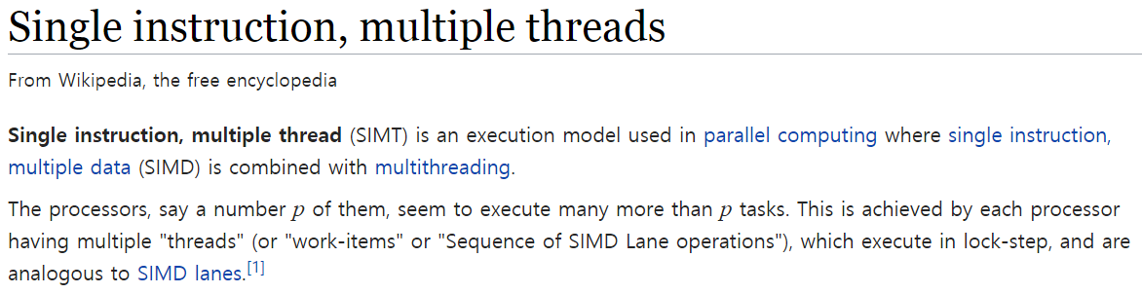
Single Instruction Multiple Data
Single Instruction/Program Multiple Data (SIMD/SPMD)
Vector Processing
Intel: MMX, SSE, AVX
ARM: NEON
Single Instruction Multiple Thread (SIMT)
GPU !

Slide 38
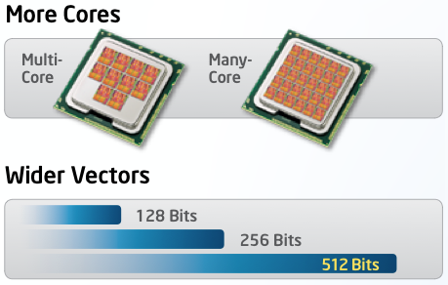
Terms
SIMD: Single Instruction Multiple Data
MMX: MultiMedia eXtensions
SSE: Streaming SIMD Extensions
AVX: Advanced Vector eXtensions (From Sandy Bridge)

Slide 39




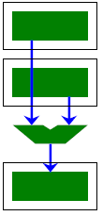
SIMD Vectorization
To sum the values of 2 arrays, a conventional CPU needs one add operation (“+”) per array index:
Reason: a register of a conventional CPU can only hold only 1 data item at a time (such a register is called a scalar register):
double | a[4] = | {1.0, | 2.0, | 3.0, | 4.0}; |  | double a[4] = {1.0, 2.0, 3.0, | 4.0};
double | b[4] = | {1.0, | 2.0, | 3.0, | 4.0}; |  | double b[4] = {1.0, 2.0, 3.0, | 4.0};
double | c[4]; |  |  |  |  |  | double c[4];
 |  |  |  |  |  |  | int i;
c[0] = | a[0] + | b[0];
c[1] = | a[1] + | b[1]; |  |  |  |  | for(i=0; i < 4; i++) {
c[2] = | a[2] + | b[2]; |  |  |  |  | c[i] = a[i] + b[i];
c[3] = | a[3] + | b[3]; |  |  |  |  | }
sequential array sum
array sum using loop
a[0]
b[0]
+
a[1]
b[1]
+
a[2]
b[2]
+
a[3]
b[3]
+
c[0]
c[1]
c[2]
c[3]

Slide 40


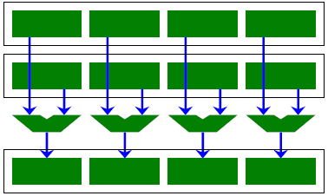
SIMD Vectorization (cont.)
Vector processors have large registers that can hold multiple values of the same data type.
double double double
_ _m256d a = {1.0, 2.0, 3.0, 4.0};
_ _m256d b = {1.0, 2.0, 3.0, 4.0};
_ _m256d c;
c = _mm256_add_pd(a,b);
data-parallel array sum using vectors
a[4] =
b[4] = c[4];
{1.0,
{1.0,
2.0,
2.0,
3.0,
3.0,
4.0};
4.0};
c[0] | = | a[0] | + | b[0];
c[1] | = | a[1] | + | b[1];
c[2] | = | a[2] | + | b[2];
c[3] | = | a[3] | + | b[3]; sequential array sum
An Intel AVX register can hold 4 double values at once:
Called a vector of 4 doubles
every double value is a vector element
_mm256_add_pd() operates on vectors
In one go, individual elements from vectors a and b are added and stored in vector c (data parallelism!)
a[0] a[1] a[2] a[3]
b[0] b[1] b[2] b[3]
+ + + +
c[0] c[1] c[2] c[3]

Slide 41


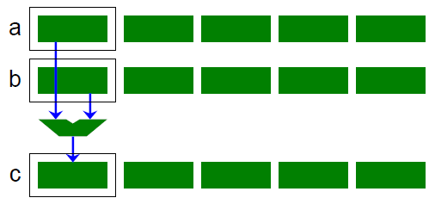
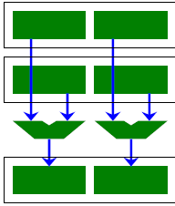
SIMD Vectorization (cont.)
Instead of arrays of integers, we can define arrays of vectors of integers:
scalar code
double a[4*MAX], b[4*MAX]; double c[4*MAX];
int ctr;
for (ctr = 0; ctr < 4*MAX; ctr++) {
c[ctr] = a[ctr] + b[ctr];
}
#define MAX ...
m256d A[MAX], B[MAX], C[MAX];
int ctr;
for (ctr = 0; ctr < MAX; ctr++) {
C[ctr] = _mm256_add_pd(A[ctr], B[ctr];
}
scalar code
vector code
C[0] = A[0] + B[0]
C[1] = ...
a[0]
a[1]
a[2]
a[3]
a[4]
b[0]
+
+
+
+
+
c[0]
scalar register
vector register

Slide 42


SIMD Vectorization (cont.)
scalar code
double a[4*MAX], b[4*MAX]; double c[4*MAX];
int ctr;
for (ctr = 0; ctr < 4*MAX; ctr++) { c[ctr] = a[ctr] + b[ctr];
}
#define MAX ...
m256d A[MAX], B[MAX], C[MAX];
int ctr;
for (ctr = 0; ctr < MAX; ctr++) {
C[ctr] = _mm256_add_pd(A[ctr], B[ctr];
}
scalar code
vector code
C[0] = A[0] + B[0]
C[1] = ...
a[0]
a[1]
a[2]
a[3]
a[4]
b[0]
+
+
+
+
+
c[0]
Vector code uses single instruction, but multiple data items (vector elements)
called Single Instruction Multiple Data (SIMD)
Scalar code operates on 1 data item per operation
called Single Instruction Single Data (SISD)

Slide 43
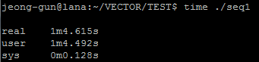
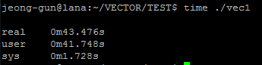
SIMD Vectorization (cont.)
scalar code
double a[4*MAX], b[4*MAX]; double c[4*MAX];
int ctr;
for (ctr = 0; ctr < 4*MAX; ctr++) { c[ctr] = a[ctr] + b[ctr];
}
#define MAX ...
m256d A[MAX], B[MAX], C[MAX];
int ctr;
for (ctr = 0; ctr < MAX; ctr++) {
C[ctr] = _mm256_add_pd(A[ctr], B[ctr];
}
With “MAX 5000000”
64 sec
43 sec
~ 1.48 Speedup < 4

Slide 44
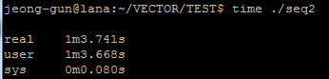
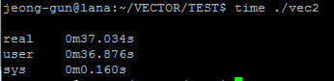
SIMD Vectorization (cont.)
scalar code
float a[4*MAX], b[4*MAX]; float c[4*MAX];
int ctr;
for (ctr = 0; ctr < 4*MAX; ctr++) { c[ctr] = a[ctr] + b[ctr];
}
#define MAX ...
m256 A[MAX], B[MAX], C[MAX];
int ctr;
for (ctr = 0; ctr < MAX; ctr++) {
C[ctr] = _mm256_add_ps(A[ctr], B[ctr];
}
With “MAX 5000000”
63 sec
36 sec
~ 1.75 Speedup < 8

Slide 45
Multiple Program Multiple Data
Multiple autonomous processors simultaneously operating at least 2 independent programs.
Typically such systems pick one node to be the "host" ("the explicit host/node programming model") or "manager" (the "Manager/Worker" strategy), which runs one program that farms out data to all the other nodes which all run a second program.
Those other nodes then return their results directly to the manager.
An example of this would be the Sony PlayStation 3 game console, with its SPU/PPU processor.

Slide 46
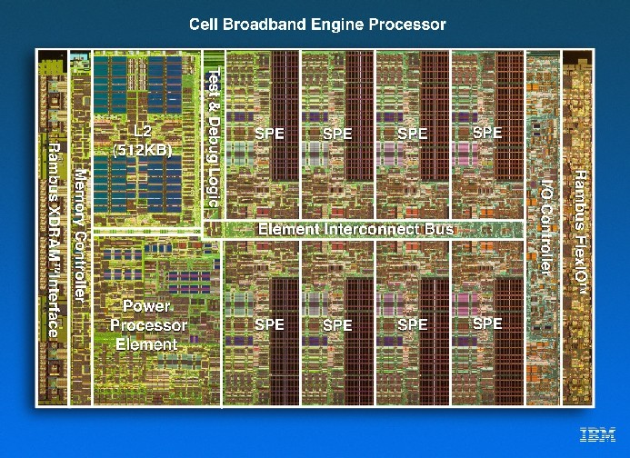
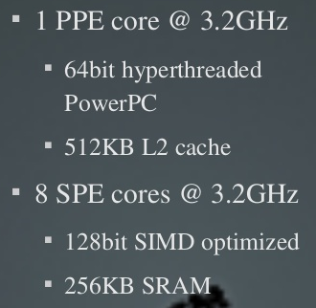
Multiple Program Multiple Data
Those other nodes then return their results directly to the manager.
An example of this would be the Sony PlayStation 3 game console, with its SPU/PPU processor.

Slide 47
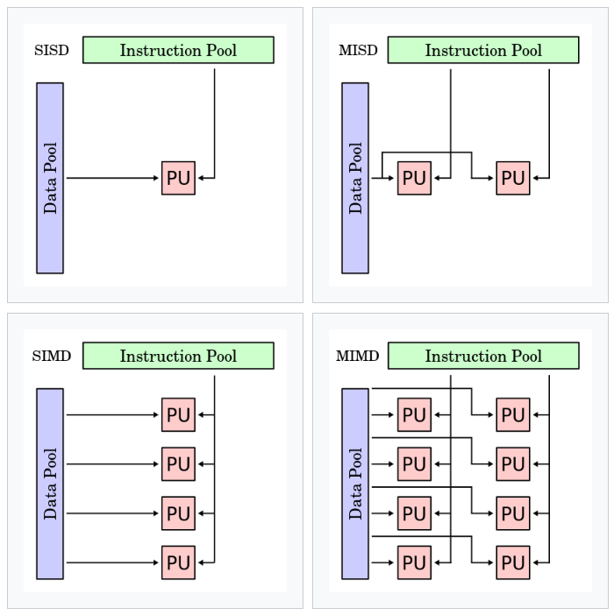
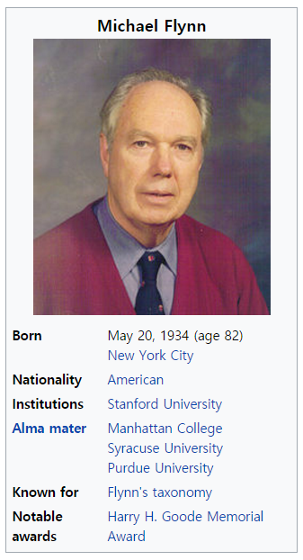
Flynn’s Classification

Slide 48
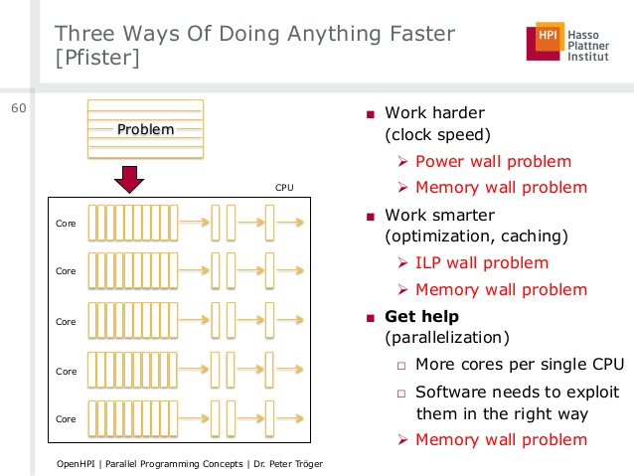

Slide 49
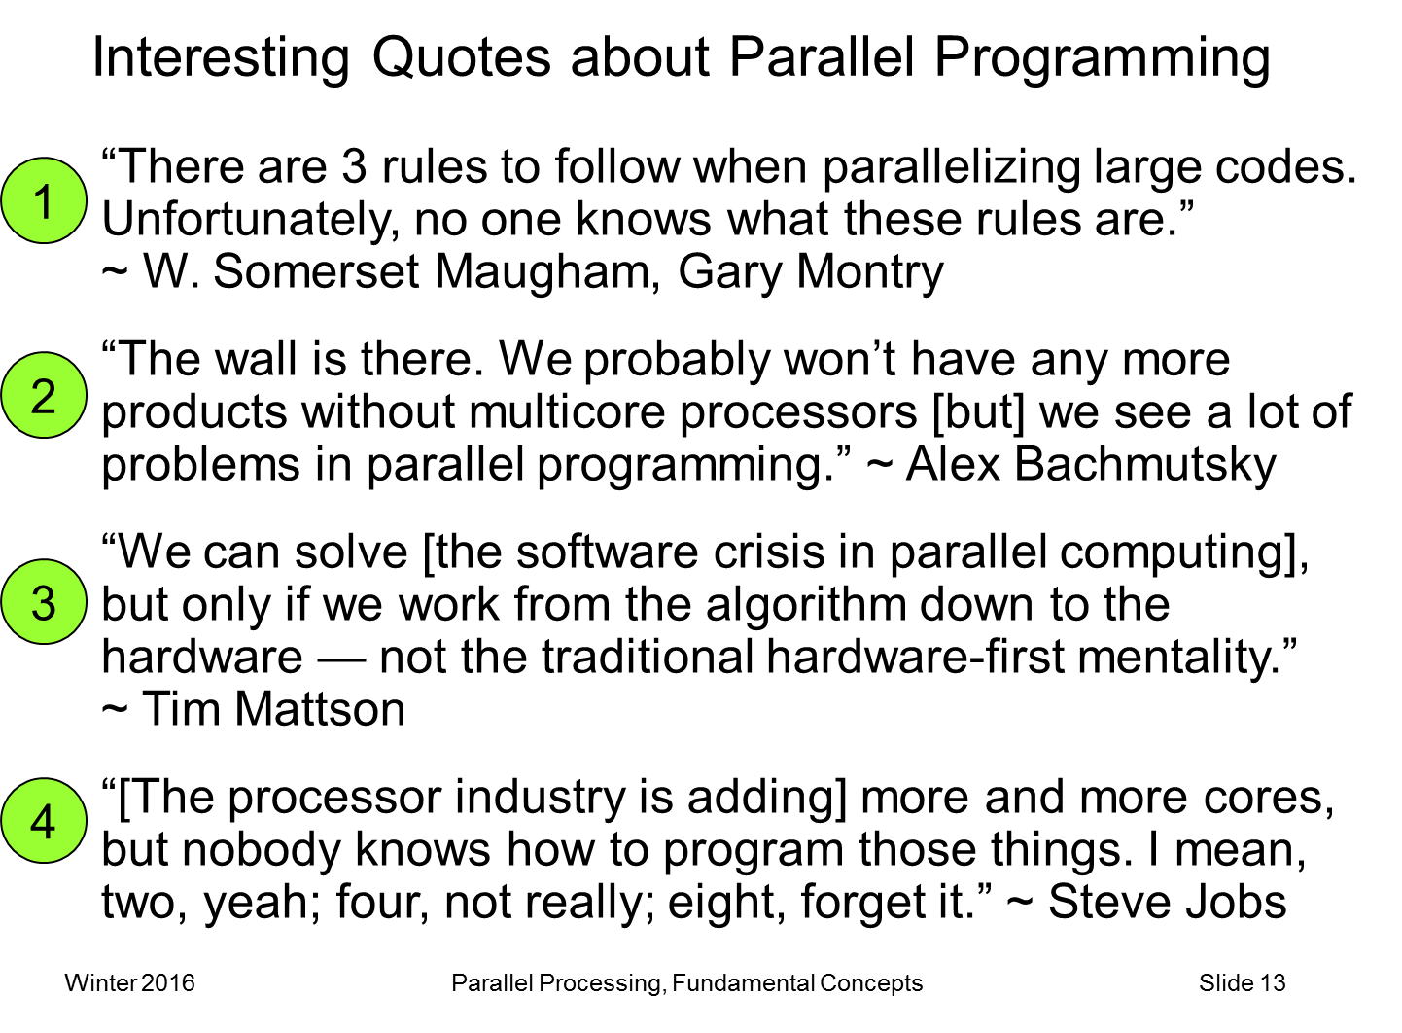

Can my code be parallelized?

Slide 50
Can my code be parallelized?
Does it have large loops that repeat the same operations?
Does your code do multiple tasks that are not dependent on one another? If not, is the dependency weak?
Is the amount of communications small?
Do multiple tasks depend on the same data?
Does the order of operations matter?

Slide 51
Guidance for Efficient Parallelization
Is it even worth parallelizing my code?
Does your code take an intractably long amount of time to complete?
Do you run a single large model or do statistics on multiple small runs?
Would the amount of time it take to parallelize your code be worth the gain in speed?

Slide 52

Guidance for Efficient Parallelization
Parallelizing established code vs. starting from scratch
Established code: Maybe easier / faster to parallelize, but my not give good performance or scaling (OpenMP)
Start from scratch: Takes longer, but will give better performance, accuracy, and gives the opportunity to turn a “black box” into a code you understand

Slide 53
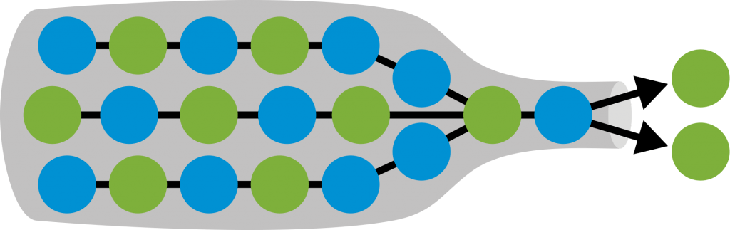
Guidance for Efficient Parallelization
Increase the fraction of your program that can be parallelized
Identify the most time consuming parts of your program and parallelize them. This could require modifying your intrinsic algorithm and code’s organization

Slide 54
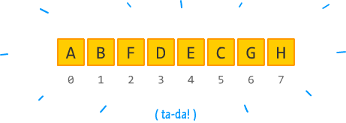
Guidance for Efficient Parallelization
Balance parallel workload
Minimize time spent in communication
Use simple arrays instead of user defined derived types
int simpleArray[MAX]

Slide 55
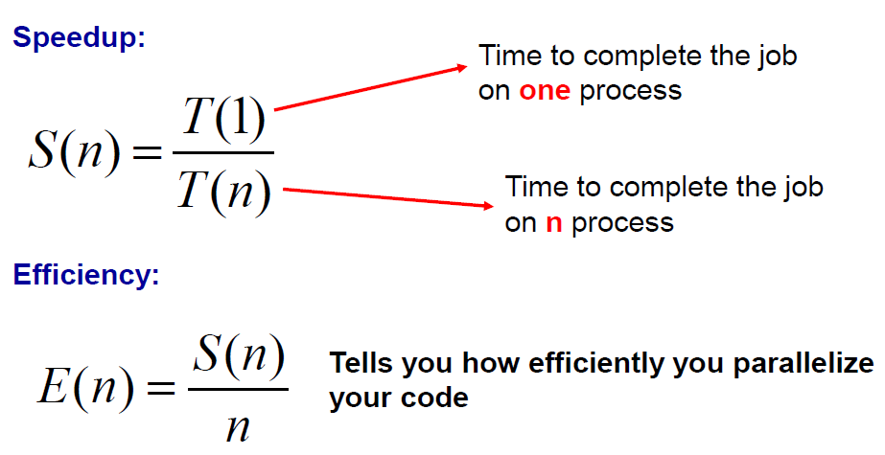
Considerations about parallelization
You parallelize your program to run faster, and to solve larger and more complex problems.
How much faster will the program run?

Slide 56
Oversimplified example
“p” : fraction of program that can be parallelized
“1 – p” : fraction of program that cannot be parallelized
“n”: number of processors
Then the time of running the parallel program will be “(1 – p) + p/n” of the time for running the serial program
80% can be parallelized & 20 % cannot be parallelized & n = 4
[1 - 0.8] + [0.8 / 4] = 0.4 i.e., 40% of the time for running the serial code
You get 2.5 speed up although you run on 4 cores since only 80% of your code can be parallelized (assuming that all parts in the code can complete in equal time)

Slide 57
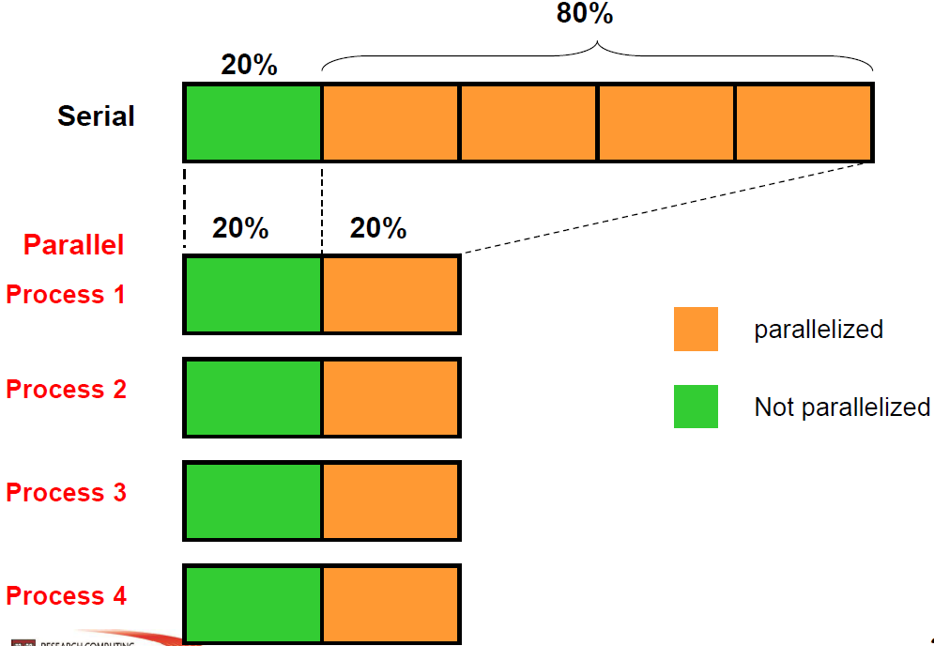
Oversimplified example

Slide 58

More realistic example:

Slide 59

Designing parallel programs - communication
Most parallel applications require tasks to share data with each other.
Cost of communication: Computational resources are used to package and transmit data. Requires frequently synchronization – some tasks will wait instead of doing work. Could saturate network bandwidth.
Latency vs. Bandwidth: Latency is the time it takes to send a minimal message between two tasks. Bandwidth is the amount of data that can be communicated per unit of time. Sending many small messages can cause latency to dominate communication overhead.
Network on a Chip !

Slide 60

Designing parallel programs - communication
Most parallel applications require tasks to share data
Synchronous vs. Asynchronous communication:
Synchronous communication is referred to as blocking communication other work stops until the communication is completed.
Asynchronous communication is referred to as non-blocking since other work can be done while communication is taking place.

Slide 61

Designing parallel programs – load balancing
Load balancing is the practice of distributing approximately equal amount of work so that all tasks are kept busy all the time.

Slide 62


Analytic Measure for Parallel Algorithms
?
분석

Slide 63

Performance Metrics for Parallel Applications
There are a number of metrics, the best known are:
Speedup
Efficiency
Redundancy
Utilization
Quality
Some laws/metrics that try to explain and assert the potential performance of a parallel application:
Amdahl Law
Gustafson-Barsis Law

Slide 64

Speedup
Speedup is a measure of performance. It measures the ration between the sequential execution time and the parallel execution time.

Slide 65

Efficiency
Efficiency is a measure of the usage of the computational resources. It measures the ration between performance and the resources used to achieve that performance.

Slide 66

Redundancy
Redundancy measures the increase in the required computation when using more processors. It measures the ration between the number of operations performed by the parallel execution and by the sequential execution.

Slide 67

Quality
Quality is a measure of the relevancy of using parallel computing.

Slide 68
Effectiveness of Parallel Processing
Task graph exhibiting limited inherent parallelism.
p Number of processors
W(p) Work performed by p processors
T(p) Execution time with p processors
T(1) = W(1); T(p) ≤ W(p)
S(p) Speedup = T(1) / T(p)
E(p) Efficiency = T(1) / [p T(p)]
R(p) Redundancy = W(p) / W(1)
Q(p) Quality = T³(1) / [p T²(p) W(p)]
W(1) = 13
T(1) = 13
T(∞) = 8

Slide 69
Reduction or Fan-in Computation
Example: Adding 16 numbers, 8 processors, unit-time additions
Zero-time communication
E(8) = 15 / (8 × 4) = 47%
S(8) = 15 / 4 = 3.75
R(8) = 15 / 15 = 1
Q(8) = 1.76
Unit-time communication
E(8) = 15 / (8 × 7) = 27%
S(8) = 15 / 7 = 2.14
R(8) = 22 / 15 = 1.47
Q(8) = 0.39
Computation graph for finding the sum of 16 numbers .

Slide 70


Matrix Multiplication ?
What about n×n matrix multiplication ?
Assume “+” or “×” take one time unit.
$$\sum_{i=0}^{n}{\sum_{j=0}^{n}{C\left[i,j\right]=\sum_{i=0}^{n}{\sum_{j=0}^{n}{\sum_{k=0}^{n}{A\left[i,k\right]∗B[k,j]}}}}}$$

Slide 71


Matrix Multiplication ?
What about n×n matrix multiplication ?
Assume “+” or “×” take one time unit.
If we have 1 processor…
n × n ×(n× +(n-1)₊) ops = n² ×(2n – 1) = O(n³)
If we have p processors = n ?
n ×(n× +(n-1)₊) ops ~ O(n²)
If we have p processors = n² ?
If we have p processors = n³ ?
$$\sum_{i=0}^{n}{\sum_{j=0}^{n}{C\left[i,j\right]=\sum_{i=0}^{n}{\sum_{j=0}^{n}{\sum_{k=0}^{n}{A\left[i,k\right]∗B[k,j]}}}}}$$

Slide 72

Matrix Multiplication ?
What about n × n matrix multiplication
Assume “+” or “×” take one time unit.
What about binary matrix multiplication ?
PRAM Architecture / Model

Slide 73
PRAM
Parallel Random Access Machine (PRAM)
Natural extension of RAM: each processor is a RAM
Processors operate synchronously
Model is refined for concurrent read/write capability
Exclusive Read Exclusive Write (EREW)
Concurrent Read Exclusive Write (CREW)
Concurrent Read Concurrent Write (CRCW)
CRCW PRAM
Common CRCW: all processors must write the same value
Arbitrary CRCW: one of the processors succeeds in writing
Priority CRCW: processor with highest priority succeeds in writing

Slide 74
Matrix Multiplication ?
What about n × n matrix multiplication
Assume “+” or “×” take one time unit.
What about binary matrix multiplication ?
All processor_i_j_k (1≤i, j, k≤n)
read A[i,k] to a;
read B[k,j] to b;
temp = a*b;
write ‘1’ to C[i,j];
write temp to C[i,j]; // with CRCW

Slide 75

Amdahl Law
The computations performed by a parallel application are of 3 types:
C(seq): computations that can only be realized sequencially.
C(par): computations that can be realized in parallel.
C(com): computations related to communication / synchronization / initialization.
Using these 3 classes, the speedup of an application can be defined as:

Slide 76


Amdahl Law
Since C(com) ≥ 0 then:
If ‘f’ is the fraction of the computation that can only be realized sequentially, then:

Slide 77

Amdahl Law
Simplifying:

Slide 78


Amdahl Law
Let 0 ≤ f ≤ 1 be the computation fraction that can only be realized sequentially.
The Amdahl law tells us that the maximum speedup that a parallel application can attain with p processors is:
The Amdahl law can also be used to determine the limit of maximum speedup that a determined application can achieve regardless of the number of processors used.

Slide 79


Amdahl Law
Suppose one wants to determine if it is advantageous to develop a parallel version of a certain sequential application. Through experimentation, it was verified that 90% of the execution time is spent in procedures that may be parallelizable. What is the maximum speedup that can be achieved with a parallel version of the problem executing on 8 processors?
And the limit of the maximum speedup that can be attained?

Slide 80
Limitations of the Amdahl Law
The Amdahl law ignores the cost with communication / synchronization operations associated to the introduction of parallelism in an application. For this reason, the Amdahl law can result in predictions not very realistic for certain problems.
Consider a parallel application, with complexity O(n²), whose execution pattern is the following, where n is the size of the problem:
Execution time of the sequential part (input and output of data):
18.000 + n
Execution time of the parallel part: n² / 100
Total communication/synchronization points per processor: ⎡log n⎤
Execution time due to communication/synchronization (n=10.000) : 1000*⎡log p⎤+n/p

Slide 81


Limitations of the Amdahl Law
What is the maximum speedup attainable?
Using Amdahl law:
Using the speedup measure:

Slide 82

Limitations of the Amdahl Law

Slide 83


Amdahl .vs. Gustafson
Amdahl’s law: “Speedup vs. Parallelism” for fixed workload
Gustafson’s law: “Speedup vs. Parallelism” for scalable workload
Speedup
Speedup
#Core
#Core
9/40

